Slide 1
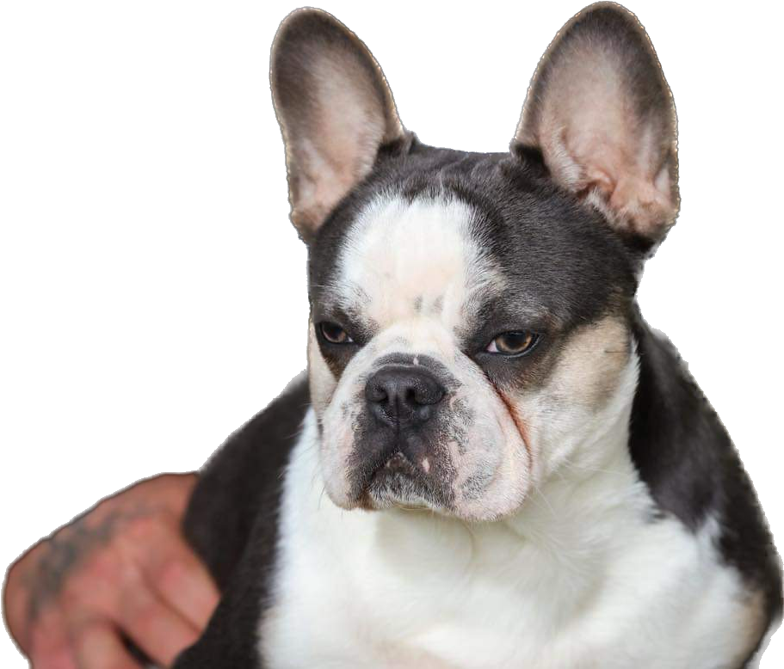
Stud Service Agreement
Stud’s Registered Name: Tyson 3rd (Elon Husk)
Description: Blue and Tan Visual Husky Carrying Cocoa, Cream and Pink
DNA Profile: at/at B/B Co/co d/d EM/e ky/ky n/s in/in
Date of Birth: 1/3/2022
AKC Registry Number NP83917301
Stud Owner(s): Clint & Cheryl Sheppard
Telephone Number: (405) 919-3064
Email: sheppsplatinumblondes@gmail.com
Bitch’s Registered Name:______________________________
Date of Birth:_______________________________________
DNA Profile:________________________________________
Description:________________________________________
AKC Registry Number:________________________________
Bitch’s Owner(s):____________________________________
Telephone Number:__________________________________
Email:_____________________________________________
All Parties involved with the Female must sign contract
Only registered owners are allowed to use stud credit
All third-party transactions are prohibited
No Dual-Sires allowed
No Direct-Line Inbreeding allowed
Semen Collections/Shipping Cost $375 covered by Bitch’s owner
(includes $200 refundable upon return of shipping items)
No refunds on collection/shipping costs due to shipping co error
Intl shipping fees will vary depending on collection method
Breed at your own risk, no guarantee on defect or congenital
Breeding should occur within 2 years of contract date
Freezing and Storage fees will apply after 2 years
Deposits are non-refundable

Slide 2
__Stud Fee of $______USD is to be paid in full before breeding will take place. A $______USD non-refundable deposit is required to lock-in the current rate and secure breeding with stud. __Pup-Back takes place of stud fee. Stud owner will receive 1 Puppy(s) from resulting litter. Order of choice will be 1st pick. Bitch owner is responsible for transportation of pup to stud owner
Breeding Terms:
Bitch owner will provide a negative Brucellosis test taken within one month of breeding date for onsite live breeding.
Bitch owner agrees to provide live video call to Stud owner during a veterinary x-ray for puppy count guarantee.
Three pups will constitute a litter. If one or two puppy litter, Stud owner will provide a re-breed free of charge. Collection/shipping charges are the responsibility of the bitch owner.
Bitch owner agrees to notify stud owner within 48 hours of whelping with results and photos/sex of each puppy.
Any pup fatalities must be reported to stud owner within 24 hours with veterinary documentation.
If pup-back, Bitch owner agrees to dewclaw DNA testing through Animal Genetics for each puppy within days 2-5. Stud owner will pay the DNA testing for each pup-back.
Stud owner guarantees a healthy and viable semen sample at the time of collection prior to shipping.
The bitch owner agrees that any verbal communications that are not listed in this contract are null and void.
If stud is unavailable due to unforeseen circumstances, stud credit may be transferred to another stud.
This contract is for the sale of viable semen. In no way is it a guarantee of a pregnancy or any number of puppies. Any semen inserted into the female is considered redeemed. Puppy guarantee is a courtesy by the Stud Owner(s), not an obligation. By the Signatures below, all parties named herein are bound to the terms above.
Date of Agreement:___________________
Stud Owner(s)_______________________________________
Bitch Owner(s)_______________________________________
Bred on:______________ Scheduled Whelping Date:_____________

